Slide 1
JOINTS IN A BUILDING
Building Construction Practice

Slide 2
Joints in buildings
Joints in buildings are intentional gaps or separations provided to accommodate movements due to thermal expansion, contraction, settlement, vibrations, and load variations.

Slide 3
Types of Joints in Buildings
1. Expansion Joints
Purpose: Allow expansion and contraction due to temperature changes.
Location: Provided in long structures, bridges, and concrete pavements.
Material Used: Rubber, bitumen, metal strips, or flexible sealants.

Slide 4
2. Contraction (Shrinkage) Joints
Purpose: Control cracks due to drying shrinkage in concrete.
Location: Found in large concrete slabs, roads, and floors.
Material Used: Preformed sealants or saw-cut grooves.
3. Construction Joints
Purpose: Separate different phases of construction when continuous pouring of concrete is not possible.
Location: Found in columns, beams, walls, and slabs.
Material Used: Bonding agents, key grooves, or dowel bars.

Slide 5
4. Settlement Joints
Purpose: Allow differential settlement in buildings with varying soil conditions or foundation depths.
Location: Provided between different structural sections of a building.
Material Used: Flexible materials like asphalt, rubber, or cork sheets.
5. Seismic Joints
Purpose: Prevent structural failure by allowing movement during earthquakes.
Location: Found in high-rise buildings, bridges, and earthquake-prone areas.
Material Used: Flexible sealants, neoprene pads, or sliding bearings.

Slide 6
6. Control Joints in Masonry
Purpose: Prevent cracks due to thermal expansion and drying shrinkage in masonry walls.
Location: Used in brick or block walls at regular intervals.
Material Used: Flexible caulking or expansion foam.
7. Isolation Joints
Purpose: Separate different structural elements (e.g., columns from slabs) to prevent stress transfer.
Location: Found in pavements, walls, and between different materials.
Material Used: Cork, rubber, or fiberboard.

Slide 7
General Considerations While Designing and Locating Joints in Buildings
When designing and locating joints in a building:
Identify the type of joint required.
Follow recommended spacing for joints.
Account for thermal, seismic, and settlement movements.
Consider foundation type and soil conditions.
Ensure material compatibility to prevent stress buildup.
Provide proper waterproofing and sealing in exposed areas.
Maintain aesthetic and functional efficiency.
A well-planned joint system enhances structural stability, durability, and long-term performance.

Slide 8
Indian Standard Recommendations for Spacing of Joints in Buildings
Type of Joint | Structural Member | Recommended Spacing
Expansion Joints | RCC Framed Structures | 30 - 45 meters
 | Brick Masonry Walls | 12 - 15 meters
 | Concrete Pavements | 25 - 30 meters
Contraction (Shrinkage) Joints | Concrete Slabs | 3 - 5 meters
 | Concrete Pavements | 4 - 6 meters
Construction Joints | Slabs, Beams, Columns, and Walls | As per construction sequence
Settlement Joints | Buildings with varying foundation levels | Where differential settlement is expected
Seismic Joints | Buildings in earthquake-prone areas | As per seismic zone analysis
Control Joints | Masonry Walls | 6 - 9 meters
Isolation Joints | Between different structural components (e.g., slab and column) | Where different materials meet
(IS 3414: 1968 – Code of Practice for Design and Installation of Joints in Buildings)

Slide 9
Jointing Materials
Various materials are used to fill, seal, or cover joints in buildings to accommodate movement, prevent water ingress, and enhance durability. These materials can be categorized based on their function and application.

Slide 10
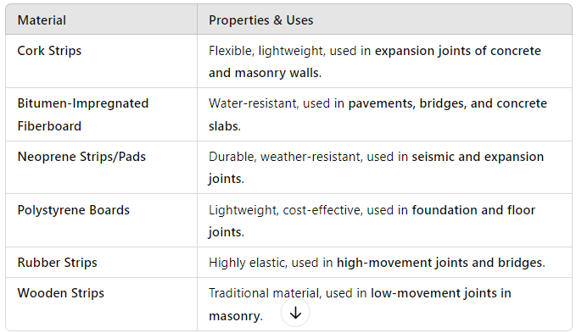
Joint Filler Materials (Compressible Materials)

Slide 11
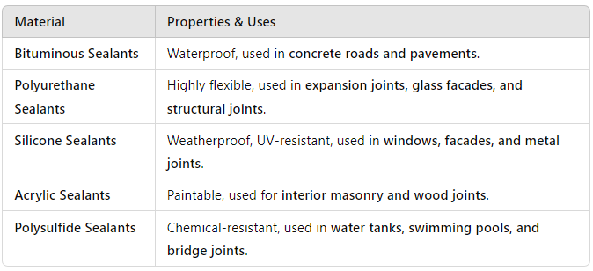
Joint Sealing Materials (Sealants & Flexible Fillers)

Slide 12
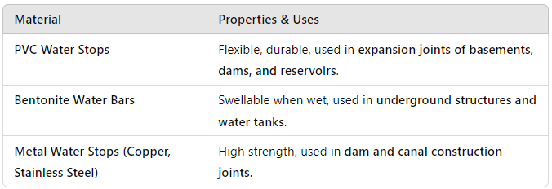
Water-Proofing Joint Materials (Water Stops & Barriers)

Slide 13
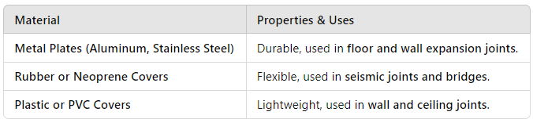
Joint Covering Materials (Protective & Aesthetic Covers)

